Slide 1
Windows Tech Series Configuration
Speaker 1
Title
Speaker 2
Title

Slide 2
Agenda
Day | Day 1 Deployment | Day 2 Management | Day 3 Security | Day 4 Windows for CSP
 |  |  |  | Deployment | Management | Security
Synopsis | Module 1 – Introduction | Module 1 – Base System Setup | Module 1 – Analysis Of Common Threats | Module 1 – Windows for SMB Partners
 | Module 2 – Applications & Updates | Module 2 – Configuration | Module 2 – Hardening Windows | Module 2 – Windows Ent. Subscription
 | Module 3 – Windows as a Service (WaaS) | Module 3 – Managing Client Devices | Module 3 – Advanced Threat Protection | Module 3 – Deployment
 | Module 4 – Browsers & Internet Security | Module 4 – Advanced management options I | Module 4 – Information Security (RMS/EDP) | Module 4 – Managing Updates
 | Module 5 – Secure Boot & Device Guard | Module 5 – Advanced management options II | Module 5 – Internet Security

Slide 3
Part 2 – Configuration
Microsoft Intune integration with System Center Configuration Manager
Client Settings in Configuration Manager
Manage Windows as a Service with System Center Configuration Manager Intune setup and initial configuration

Slide 4
Windows 10 management with new Configuration Manager
KEEP WINDOWS UP TO DATE
Product version | Release vehicle | Availability | Windows 10 features supported | Support | Windows Servicing Model supported
System Center Configuration Manager | Current Branch | Generally available on 12/8/2015 with updates released periodically throughout the year | New features, security updates, and bug fixes | Can defer updates for up to 12 months before you must deploy updates to maintain support | Windows 10 Current Branch, Current Branch for Business, and Long Term Servicing Branch
System Center Configuration Manager
Periodic updates every few months
Current Branch (version 1511)
Current Branch (version yymm)
Current Branch (version yymm)
Technical Preview (version yymm)
Fall 2015
WINTER
2016

Slide 5








Enterprise mobility management with Intune
Mobile device management
Mobile application management
PC management
User
IT
Microsoft Intune
Intune helps organizations provide their employees with access to corporate applications, data, and resources from virtually anywhere on almost any device, while helping to keep corporate information secure.

Slide 6
Comprehensive lifecycle management
Enroll
Provide a self-service Company Portal for users to enroll devices
Deliver custom terms and conditions at enrollment
Bulk enroll devices using Apple Configurator or service account
Restrict access to Exchange email if a device is not enrolled
Provision
Deploy certificates, email, VPN, and WiFi profiles
Deploy device security policy settings
Install mandatory apps
Deploy app restriction policies
Deploy data protection policies
User
IT
Retire
Revoke access to corporate resources
Perform selective wipe
Audit lost and stolen devices
Manage and Protect
Restrict access to corporate resources if policies are violated (e.g., jailbroken device)
Protect corporate data by restricting actions such as copy, cut, paste, and save as between Intune-managed apps and personal apps
Report on device and app compliance

Slide 7
Enterprise Mobility Suite + Office 365
Office 365
Productivity
Integrated experiences
Enterprise Mobility Management
Access control to cloud services
Data leakage prevention
Require MDM to access email
Enterprise app store
Secure collaboration
Device and app compliance reporting
Device and user provisioning
Single sign on
Employee leaves the company
…and more in the works
Azure AD
Identity and Access
Intune
Management
Azure RMS
File Encryption and Policy
Advanced Threat Analytics

Slide 8

Deployment flexibility
Intune standalone (cloud only)
Configuration Manager integrated with Intune (hybrid)
IT
IT
Intune web console
Configuration Manager console
System Center Configuration Manager
Mobile devices and PCs
Domain joined PCs
Mobile devices

Slide 9
Deployment flexibility
Intune standalone (cloud only)
Manage and Protect
No existing infrastructure necessary
No existing Configuration Manager deployment required
Simplified policy control
Simple web-based administration console
Faster cadence of updates
Always up-to-date
IT
Intune web console
Devices Supported
Windows 7 and later
Windows Phone 8.0 and later
Windows RT 8.0 and later
iOS 7.1 and later
Android 4.0 and later
OS X 10.9 and later
Mobile devices and PCs

Slide 10
Deployment flexibility
System Center Configuration Manager with Microsoft Intune
Build on existing Configuration Manager deployment
Full PC management (OS deployment, endpoint protection, application delivery control, custom reporting)
Deep policy control requirements
Greater scalability
Extensible administration tools (RBA, PowerShell, SQL reporting services)
Configuration Manager integrated with Intune (hybrid)
IT
Configuration Manager console
System Center Configuration Manager
Devices Supported
Windows PCs (x86/64, Intel SoC)
Windows to Go
Windows Server
Linux
OS X
Windows RT
Windows Phone 8.x
iOS
Android
Domain joined PCs
Mobile devices

Slide 11
Management Labs Module 02-01: Microsoft Intune integration with SCCM Module 02-02: Windows Store for Business setup and configuration Module 02-03: Client Settings in Configuration Manager

Slide 12

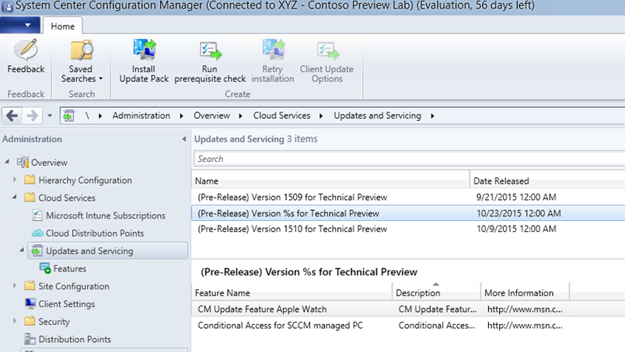
Updates and Servicing node
KEEP WINDOWS UP TO DATE
Download and install updates for:
Configuration Manager
Intune extensions
Cumulative updates
Designed for Windows 10 CB/CBB
More frequent and easier to install directly from the admin console
Choose what features to enable
Run prerequisite checks
Update sites, clients, and consoles
Offline mode

Slide 13
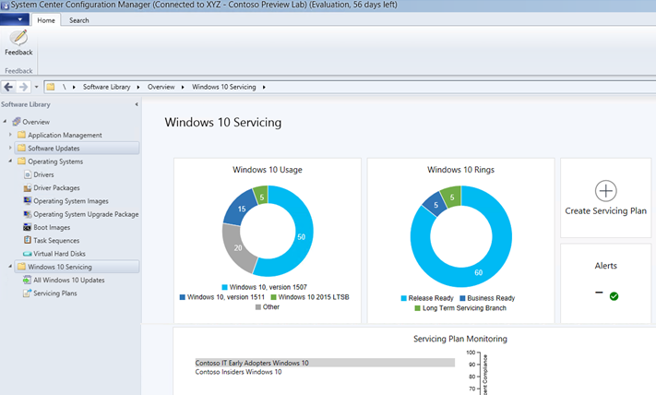
Dashboard and deployment rings
KEEP WINDOWS UP TO DATE
New dashboard to view current state of Windows as a Service
Create Servicing Plans to automatically maintain latest Windows 10 builds
Build custom deployment rings to meet business requirements
Easily monitor Windows deployment compliance

Slide 14
Management Labs Module 02-04: Manage Windows as a Service with SCCM

Slide 15
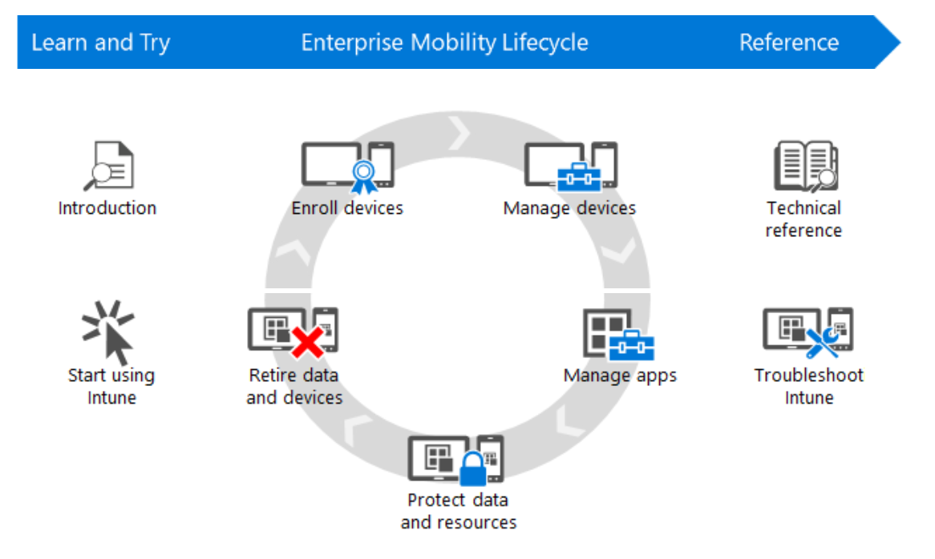
Documentation for Microsoft Intune
https://technet.microsoft.com/library/jj676587.aspx

